Slide 2
Waiver Scheme
Section 128A of CGST Act 2017
Overview
Mode of payment of tax
Time limit for payment of tax
Conditions for Waiver
Process flow of Waiver scheme including Forms and its timeline
Other Important points
Application from taxpayer’s dashboard
Processing of application at BO dashboard
Notes:
Facilitation Notes: N/A

Slide 3
Waiver Scheme
Overview
Waiver of interest and penalty, if taxpayer pays full amount of tax demanded in notice/order under Section 73
Notice or statement issued under section 73 but no order passed or
SPL-01
Tax Periods
2017-18
2018-19
2019-20
Not Applicable for:
Erroneous refund
Demand pertaining to period other than 1st July 2017 to 31st March 2020
Order issued under section 73 and no order issued by Appellate Authority or Revisional Authority or
SPL-02
Order issued by Appellate Authority or Revisional Authority, and no order passed by Appellate Tribunal
Proceedings in respect of notice or order shall be deemed to be concluded
Notes:
Facilitation Notes: N/A

Slide 4
Waiver Scheme
Assignment of SPL-01/SPL-02
SPL-01 application is assigned to the same Adjudicating Authority who issued Original Notice/ Statement
SPL-02 application is assigned to Recovery Officer (if Order is issued by State officer then its SPL-02 is assigned to the Recovery Officer of that Same State)
Once SPL-01/SPL-02 application is filed by Taxpayer then an Alert will be available to the Officer in Alert section
Officer can click on Alert icon to view the Alert
To view the Alert, the Recovery Officer will click on Recovery Officer Tab and Adjudicating Officer will click on Adjudicating Authority Tab in Alerts page
Notes:
Facilitation Notes: N/A

Slide 5
Waiver Scheme
Waiver scheme in case of Section 75(2)
In case of Original notice/ order was issued under section 74 but remanded back for redetermination of case under Section 73 in accordance with Section 75(2)
Tax demanded in order is to be paid within 6 months from the date of issuance of the order under Section 73
Taxpayer can apply for waiver scheme within 6 months from the date of communication of the order under Section 73 by filing SPL-02
Notes:
Facilitation Notes: N/A

Slide 6
Waiver Scheme
Mode of payment of tax
Application | Cases | How to make payment
SPL-01 | Notice or statement is issued under section 73 | Through DRC-03
SPL-02 | Order issued under section 73 or order by Appellate Authority or Revisional Authority | Payment against the debit entry in Part II of E-Liability Register
 |  | Where tax paid through DRC-03 against any demand order File an application in GST DRC-03A before filing application in SPL-02 Date of payment of tax paid shall be date of filing of DRC-03

Slide 7
Waiver Scheme
Time limit for payment of tax
Time limit for payment of tax
Cases | Description | Time Limit
Case A | Notice, Statement issued under Section 73 Order issued under Section 73 Order issued by Appellate Authority or Revisional Authority | On or before 31.03.2025
Case B | Redetermination of Tax under Section 73 in accordance with Section 75(2) | Within in six months of that order
Where additional liability determined in the order of Appellate Authority, Appellate Tribunal, Court or Revisional Authority |  | Within three months of that order
Notes:
Facilitation Notes: N/A

Slide 8
Waiver Scheme
Coverage of Waiver Scheme
Waiver scheme includes
Interest under Section 50
Waiver scheme does not include
Late fee, redemption fine etc.
Penalties under Section 73, 122, 125, etc.
Interest or penalty already paid (no refund for paid amounts)
demanded in notice/ statement/ order issued under section 73
Notes:
Facilitation Notes: N/A

Slide 9
Waiver Scheme
Conditions for Waiver
In case Appeal has been filed against the demand order then it needs to be withdrawn before filing application for waiver. And applicant has to upload:
Order for Appeal Withdrawal, if available
Withdrawal Application where the order for withdrawal has not been issued yet and Order for withdrawal within one month of the issuance of the such order
In case total demand as per notice or order includes, tax payable besides amount payable due to Section 16(4) which is eligible for Section 16(5) or 16(6):
amount payable for SPL-01 or SPL-02 can be reduced by the amount not payable in accordance with section 16(5) or 16(6)
if application is being filed under waiver scheme, no requirement to file a separate Application for rectification of order for Section 16(5) or 16(6) in such case
Notes:
Facilitation Notes: N/A

Slide 10
Waiver Scheme
Important points
For each notice, statement or order, separate application in SPL-01 or SPL-02 is to be filed
Where notice, statement or order includes tax on account of
erroneous refund or
for periods other than those covered by waiver scheme,
full payment of tax amount demanded needs to be made before filing application
Notes:
Facilitation Notes: N/A

Slide 11
Waiver Scheme
Important points
In case of any Departmental proceedings against the order applied for in waiver scheme
by way of an appeal before the Appellate Authority or the Appellate Tribunal or the court or revision by the Revisional Authority
and order is issued enhancing tax liability
then additional amount of tax payable needs to be paid within three months from the date of the said order
No appeal by taxpayer shall lie against the order for which SPL-02 was filed, where:
All amounts payable have been paid and
Proceedings are concluded as per the waiver scheme
Notes:
Facilitation Notes: N/A

Slide 12
Waiver Scheme
Insertion of Waiver Scheme
Provisions related to Waiver Scheme
Section 128A – By Finance Act, 2024 effective from 01.11.2024
Procedure (Rules) and conditions related to Waiver Scheme
Rule 164 notified vide Notification No. 20/2024 (CT) - 08.10.24
Dates for payment of Tax
Notification No. 21/2024 (CT) – 08.10.24
Clarification of various doubts related to Waiver Scheme
Circular no. 238/32/2024 - 15.10.24

Slide 13
Waiver Scheme
Summary of Forms
Rules | Brief description | Forms | Time Limit
164(1) | Notice/ statement issued under Section 73 | SPL – 01 | 3 months from 31-03-2025
164(2) | Order-in-Original issued but Order-in-Appeals is pending | SPL – 02 | 3 months from 31-03-2025
164(2) | Order-in- Appeals issued but Tribunal order pending | SPL – 02 | 3 months from 31-03-2025
Proviso to 164(6) | Redetermination of Tax under Section 73 in accordance with Section 75(2) [first Proviso to Section 128A(1)] | SPL – 02 | 6 months from date of communication of Order
164(8) | Show Cause Notice | SPL – 03 | 3 months from SPL-01/02
164(9) | Reply by Taxpayer | SPL – 04 | 1 month from SPL-03
164(10) | Approval order | SPL – 05 | 3 months from SPL-04 / 4 months from SPL-03
164(12) | Rejection order | SPL – 07
164 (15) | Favorable Order of Appellate Authority | SPL - 06
164 (15) | Undertaking by taxpayer | SPL – 08

Slide 14
Waiver Scheme
Officer’s Dashboard

Slide 15
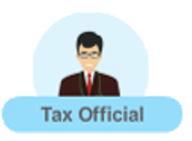
Waiver Scheme
Process flow of Waiver scheme
SPL-01
Adjudicating Authority
Action by Tax Officer
Application within
- 3 months from 31.03.2025 or
- 6 months from the Order u/s 75(2)
No Action taken
Taxpayer
Taxpayer
SPL-02
Recovery Officer
YES
Whether satisfied with SPL01/02
Deemed
Approval/
Proceedings Concluded
NO
YES
within 3
months of SPL01/02
within 3 months from SPL 01/02
within 3
months of SPL01/02
SCN in SPL-03
No Reply
within 4 months from SPL 03
No Reply
within 1 month
Whether satisfied with Reply
YES
Reply in SPL-04
SPL-05
within 3 months from SPL 04
NO
Notes:
Facilitation Notes: N/A

Slide 16
Waiver Scheme
Process flow of Waiver scheme
within 4 months from SPL 03
In case of no reply
within 3 months from SPL 04
Whether Appeal Filed ?
Appellate Authority
Rejection Order in
SPL-07
Taxpayer
YES
NO
Not satisfied with appeal i.e. rightly rejected by officer
(APL-04)
Satisfied with appeal i.e. wrongly rejected by officer
Taxpayer
Undertaking
Taxpayer
Original appeal withdrawn shall be restored
SPL - 08 Undertaking
SPL-06
(Proceeding concluded)
Notes:
Facilitation Notes: N/A

Slide 17
Waiver Scheme
No auto-approval scenarios
Waiver Application will not be deemed approved in following cases:
Applications involving erroneous refund
Applications involving MFY demand notice or order
Tax payment has been done partially or not done
Where part payment of interest or penalty is made
Amount ineligible under Section 16(4) but eligible under Section 16(5) or 16(6) is mentioned by taxpayer in SPL-01/SPL-02
Withdrawal of appeal cases reported in SPL-01/02
Manual notices or orders mentioned in SPL-01/02
Tax paid is greater than the tax demanded in the Notice/ Order
Officer has issued SPL-03

Slide 18
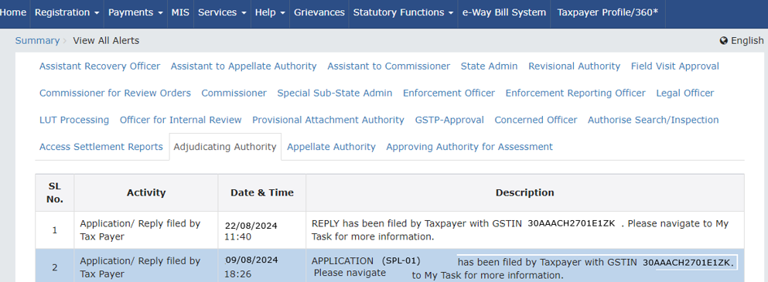
Waiver Scheme
Alerts to Adjudicating Authority
On filing of SPL-01, alert to the Adjudicating Authority on clinking of bell icon

Slide 19
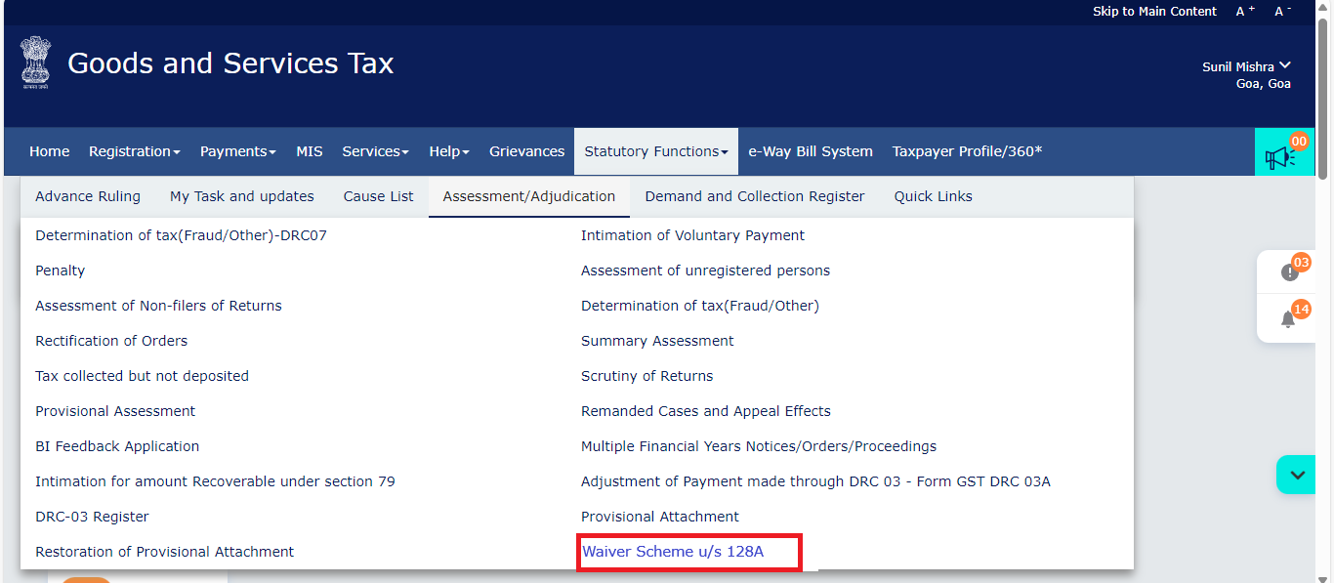
Waiver Scheme
Path for Adjudicating Officer
Navigation Path for Adjudicating Authority

Slide 20
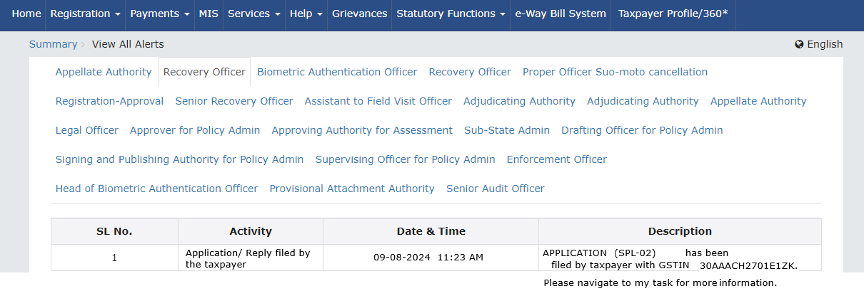
Waiver Scheme
Alerts to Recovery Officer
On filing of SPL-02, alert to the Recovery Officer on clinking of bell icon

Slide 21
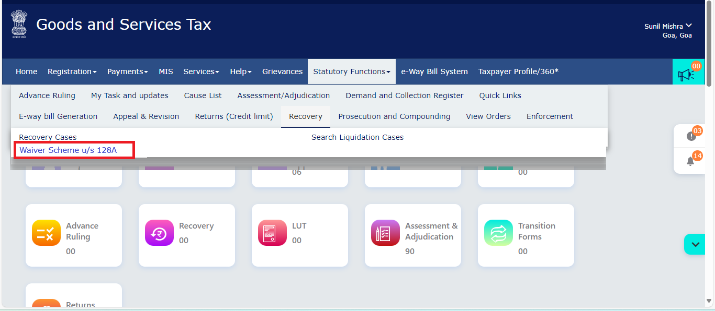
Waiver Scheme
Path for Recovery Officer
Navigation Path for, Recovery Officer

Slide 22
Waiver Scheme
My Task & Updates
Task created in “My task and Updates”

Slide 23
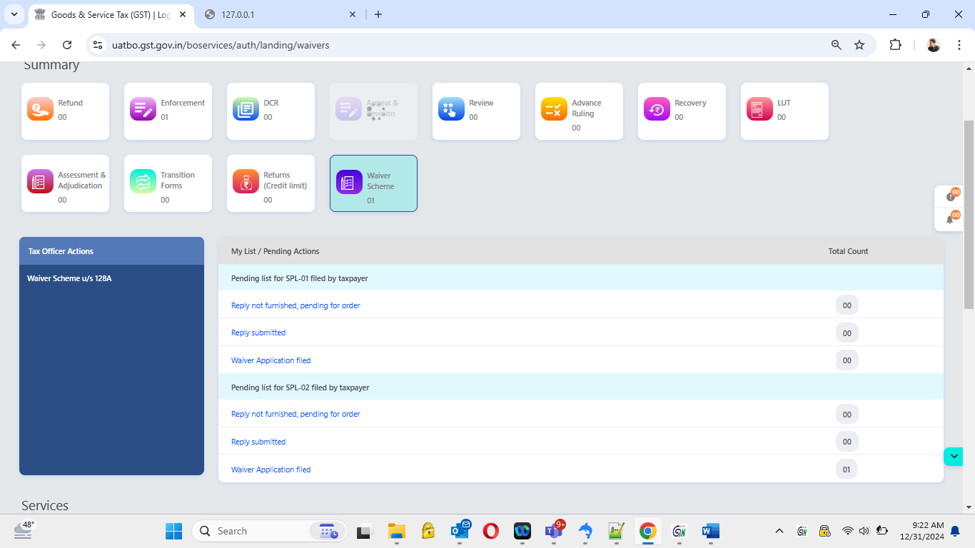
Waiver Scheme
Dashboard
A New tile created called “Waiver Scheme”
On clicking the hyperlink in blue pane, it will redirect to the Search page

Slide 24
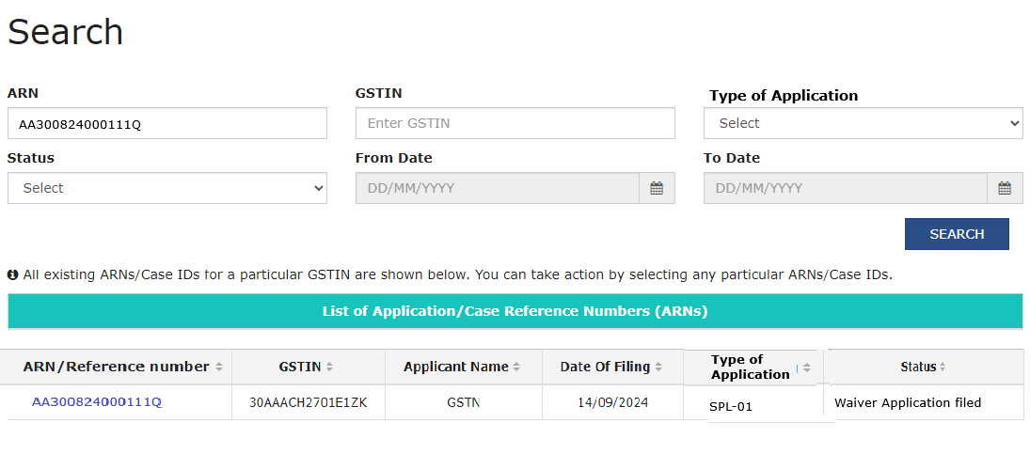
Waiver Scheme
Search Page
Search can be done based on ARN, GSTIN, Type of Application, Status of the case and From & To dates

Slide 25
Waiver Scheme
Search Page
Various statuses on search page

Slide 26
Waiver Scheme
Search Page
On click of “Waiver Application Filed” link on home screen

Slide 27
Waiver Scheme
Process flow at Back Office
Case Folder
Applications
Notices
Replies
Payment
Proceedings
Orders
References
SPL 01
SPL 02
SPL 03
Adjournment
Reminder
Reply to SPL 03
Upload withdrawal Order
Additional Information
Personal Hearing
SPL 05
SPL 07
Void Order
Communication
References
In DRC 03 w.r.t. notice or statement for SPL 01
Action Tabs
View Tabs

Slide 28
Waiver Scheme
Case Folder
Case folder on clicking of the ARN. In Application section, officer can view the application along with attachment made by taxpayer

Slide 29
Waiver Scheme
Notice
Notices tab

Slide 30
Waiver Scheme
Notice
Before issuing notice if officer click on adjournment/reminder

Slide 31
Waiver Scheme
Notice
Notice (SPL-03) Screen - 1, Due date of Reply will be auto populated - One month from SPL-03

Slide 32
Waiver Scheme
Notice
Notice (SPL-03) Screen - 2 – Not opted for Personal Hearing

Slide 33
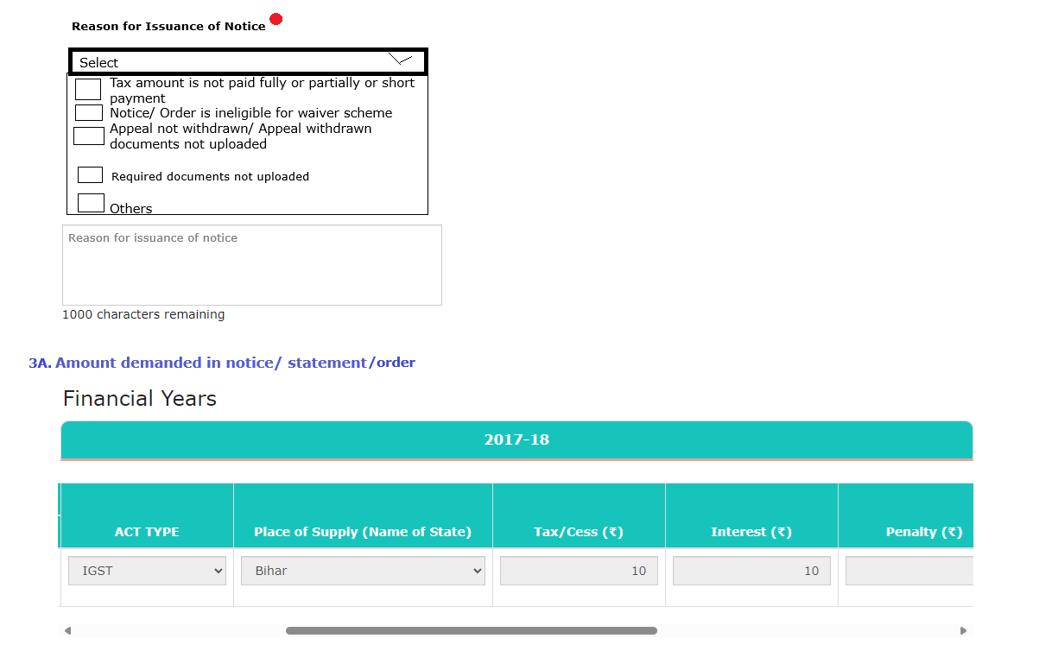
Waiver Scheme
Notice
Notice (SPL-03) Screen - 3

Slide 34
Waiver Scheme
Notice
Notice (SPL-03) Screen - 4

Slide 35
Waiver Scheme
Notice
Notice (SPL-03) Screen - 6

Slide 36
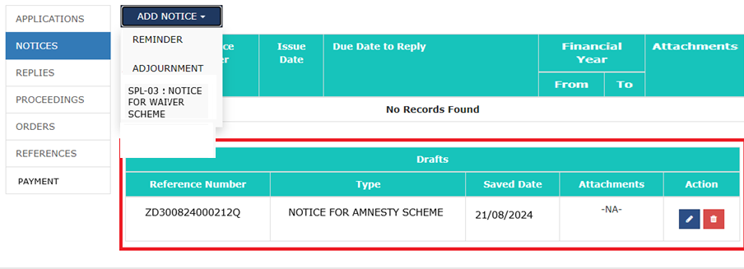
Waiver Scheme
Notice
On click on “SAVE” button, officer will be able to see a successful information message as –
“Notice is saved successfully, please proceed to issue with DSC. The saved drafts will be deleted if not submitted within 15 days from today.”
Screen after saving the notice

Slide 37
Waiver Scheme
Notice
Save, Preview and Sign PDF are mandatory field for the officer, and it should be done sequentially
If officer makes any changes even after clicking on Save and Preview, officer must again click on Save and Preview before issuing the notice
Amount Short paid to be entered by the officer as required in Screen 6
In case officer wants to fill a new fresh notice and is also having a saved draft application, then tax officer has to delete the older application, and can click on “SPL-03 : NOTICE FOR WAIVER SCHEME”
Satisfied with the SPL-01 or SPL-02, then the tax officer can directly issue SPL-05
Preview is ok, officer can proceed with attaching DSC after clicking on Sign PDF
Notice once issued, officer can not issue another notice for same case ID

Slide 38
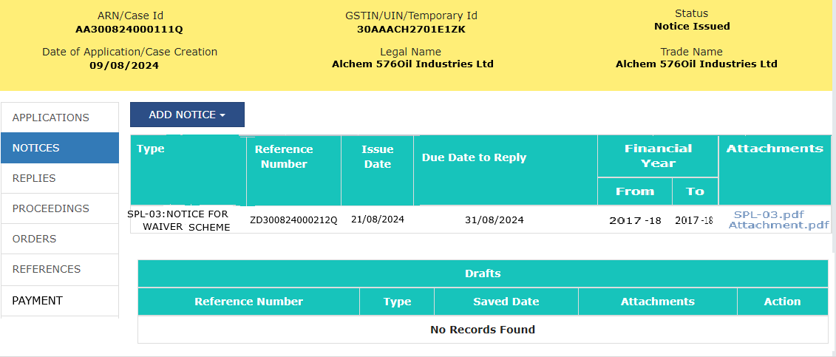
Waiver Scheme
Notice
Post Issuance of SPL-03 in BO Portal

Slide 39
Waiver Scheme
Notice
(SPL-03) Change in Screen 6 in case of SPL-02

Slide 40
Waiver Scheme
Adjournment
An adjournment option has been given to taxpayer as well as tax officer
There is no time limit for raising the adjournment request until the order is issued

Slide 41
Waiver Scheme
Reminder
In Reminder, “Due Date of Reply” gets auto-populated from the SPL-03

Slide 42
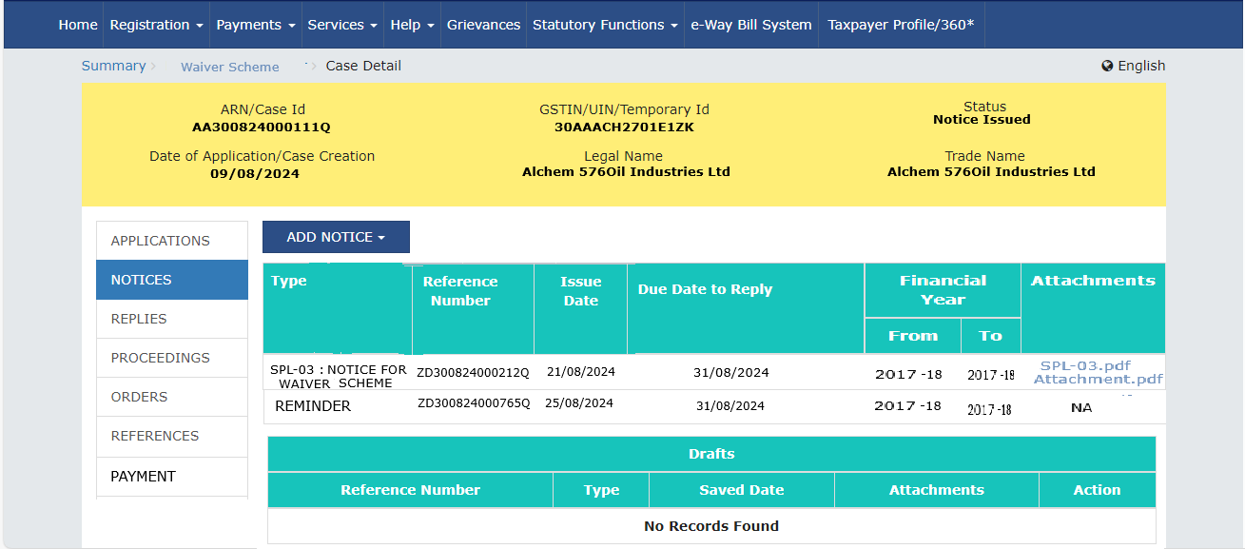
Waiver Scheme
Reminder
Post issuance of Reminder

Slide 43
Waiver Scheme
Replies Tab
All the correspondence received from taxpayer

Slide 44
Waiver Scheme
Alerts for correspondence from taxpayer
In alert section, all alerts for the correspondence received from taxpayer is visible

Slide 45
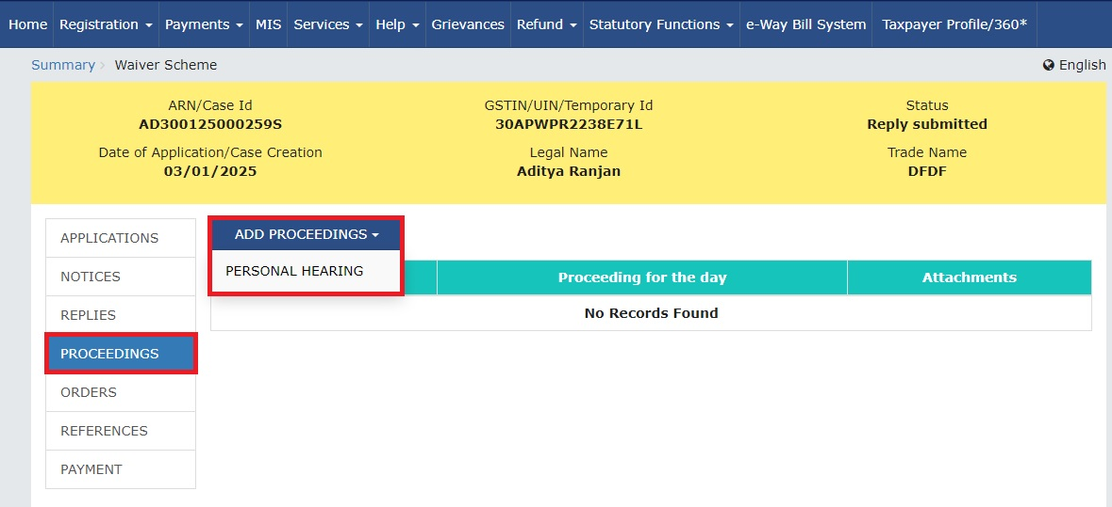
Waiver Scheme
Proceedings
Click on Proceedings tab. Select Personal Hearing option from “ADD PROCEEDINGS “ dropdown list

Slide 46
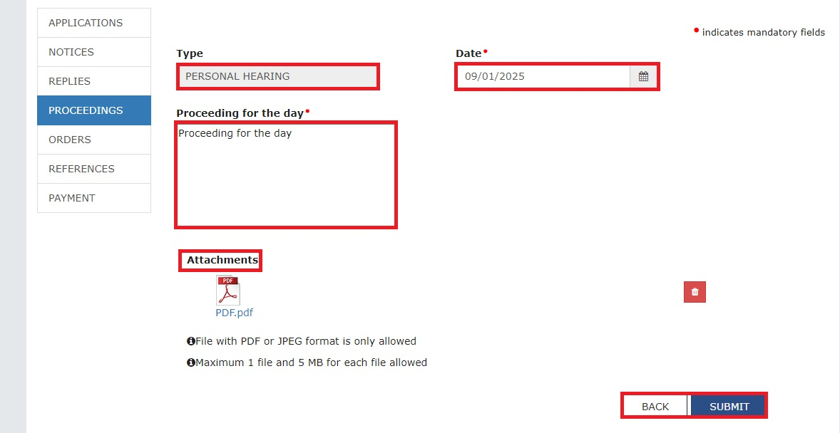
Waiver Scheme
Proceedings
On selecting “Personal Hearing”

Slide 47
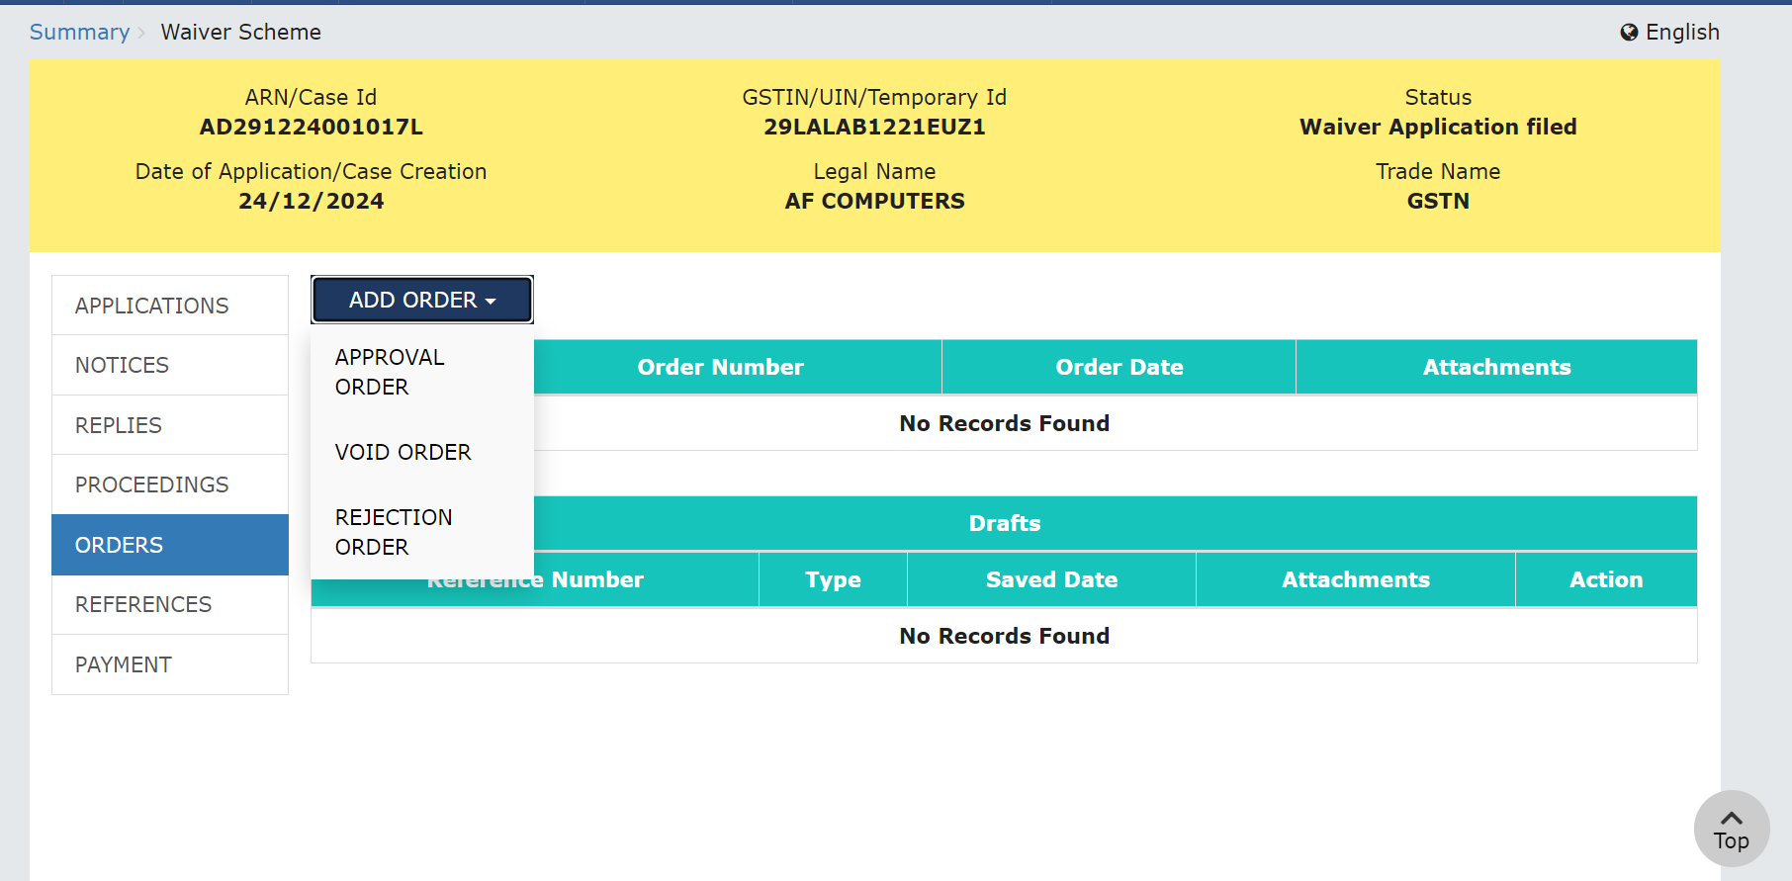
Waiver Scheme
Order Tab
Officer can issue following types of Orders

Slide 48
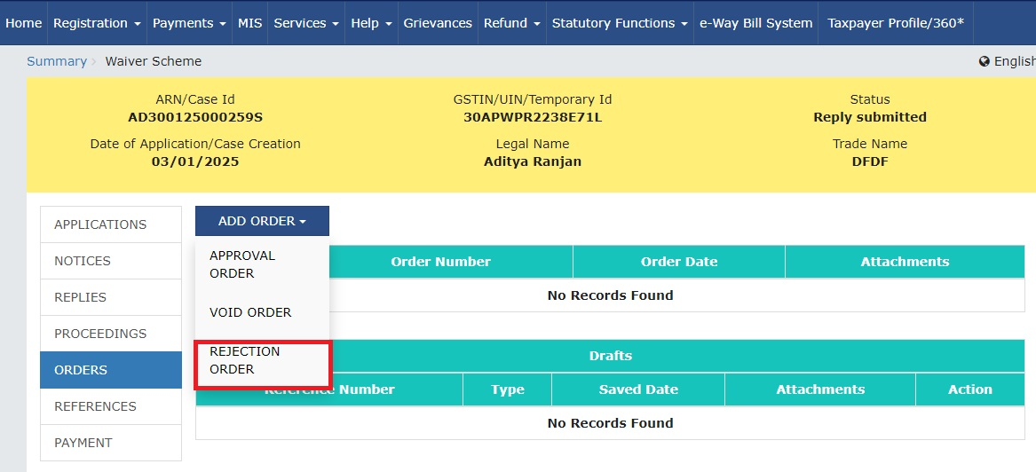
Waiver Scheme
Order Folder- Rejection Order
(SPL-07) Select Rejection Order option from Add Order dropdown list

Slide 49
Waiver Scheme
Order Folder- Rejection Order
(SPL-07) After selecting Rejection Order

Slide 50
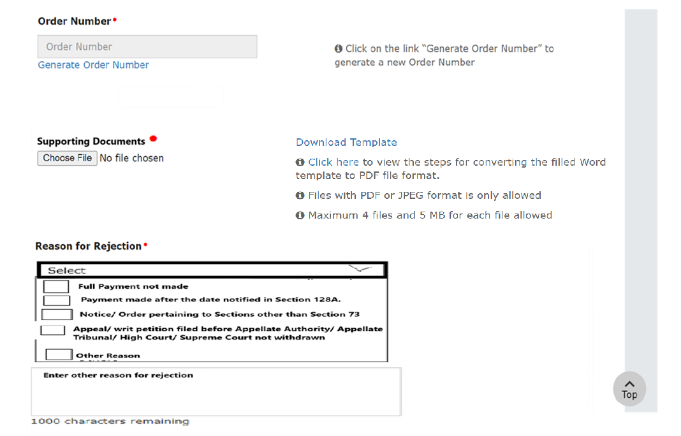
Waiver Scheme
Order Folder- Rejection Order
(SPL-07)

Slide 51
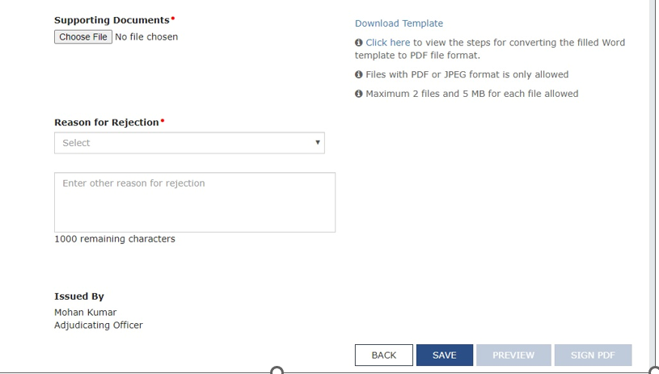
Waiver Scheme
Order Folder- Rejection Order

Slide 52
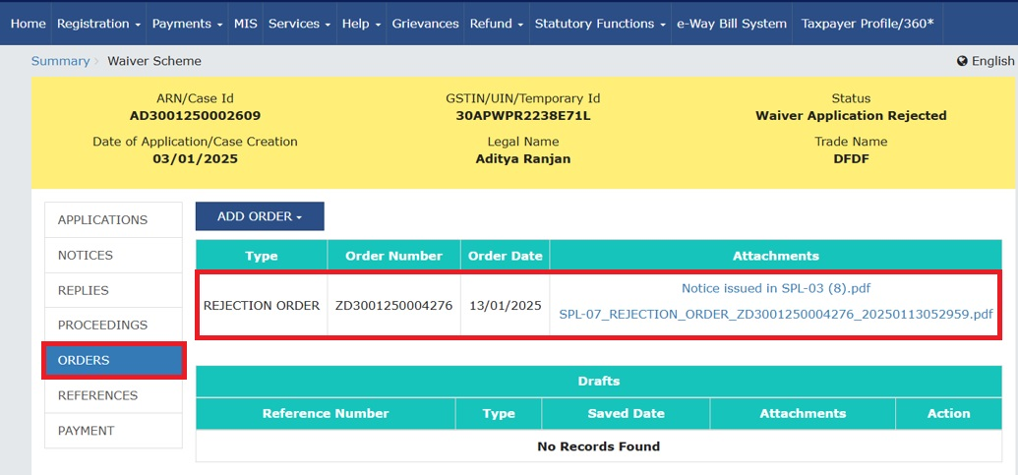
Waiver Scheme
Order Folder- Rejection Order
Screen post rejection order:

Slide 53
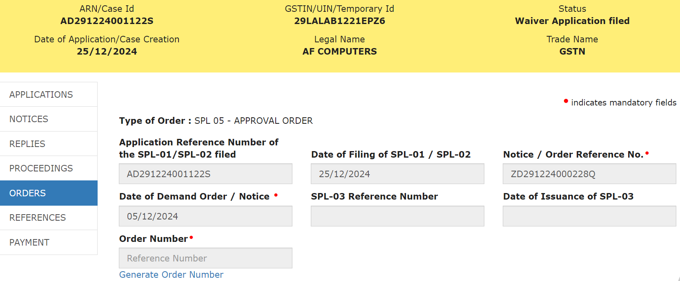
Waiver Scheme
Order Folder- Approval order
On clicking of ‘APPROVAL ORDER’ officer will be navigated to SPL-05 screen

Slide 54
Waiver Scheme
Order Folder - Approval order
SPL-05 screen

Slide 55
Waiver Scheme
Order Folder - Approval order
SPL-05 screen

Slide 56
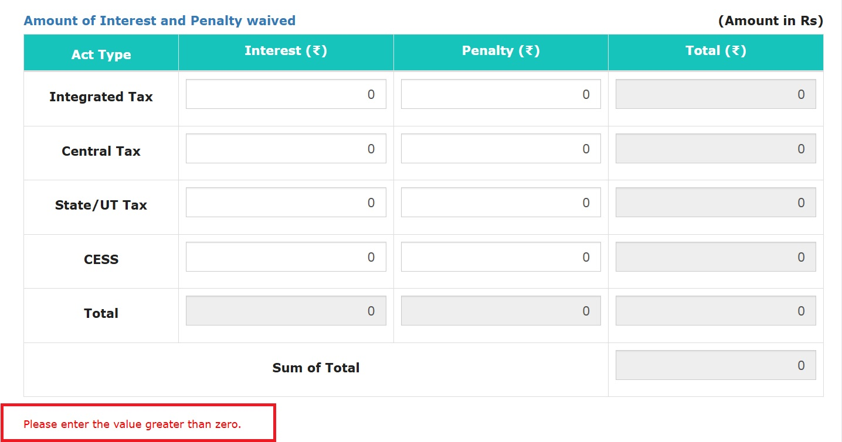
Waiver Scheme
Order Folder - Approval order
If officer does not enter any value in this table

Slide 57
Waiver Scheme
Order Folder - Approval order
SPL 05 screen
Remaining amount of Interest/ Penalty payable, if any, like:
Interest pertaining to erroneous refund or
Interest on account of demand pertaining to period other than 2017-18, 2018-19 & 2019-20

Slide 58
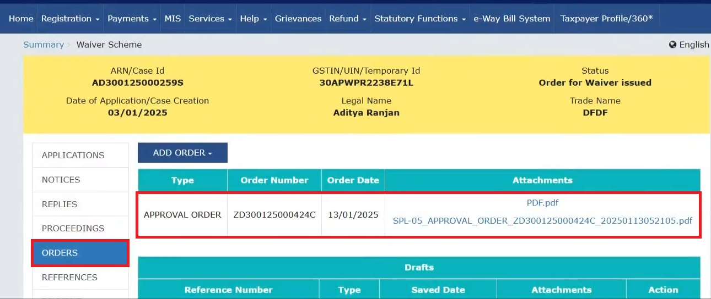
Waiver Scheme
Order Folder - Approval order
On issuance of SPL-05

Slide 59
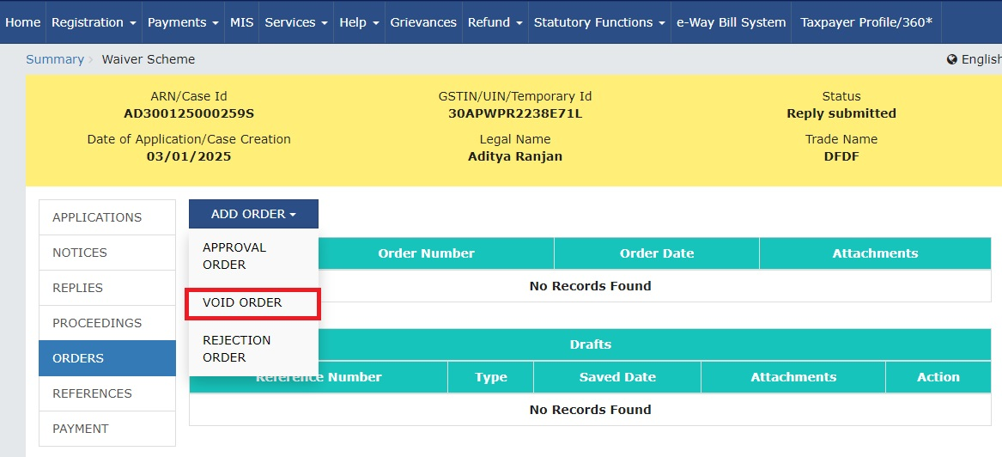
Waiver Scheme
Order Folder- Void Order
After clicking on Add Order dropdown

Slide 60
Waiver Scheme
Order Folder- Void Order
After clicking on Void Order- Contd.

Slide 61
Waiver Scheme
Order Folder- Void Order

Slide 62
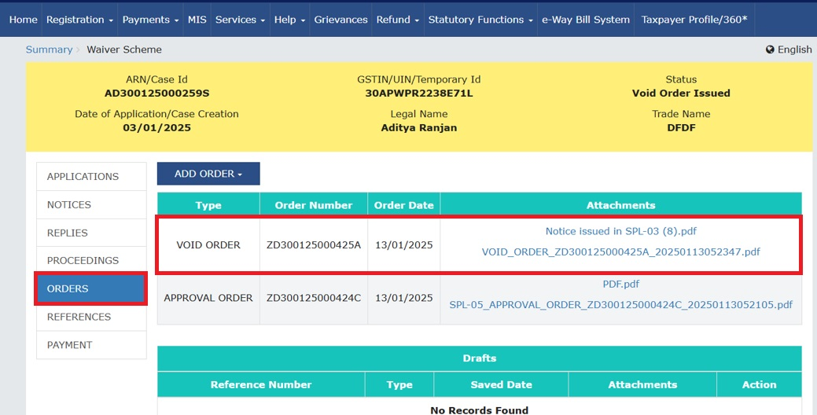
Waiver Scheme
Order Folder- Void Order
After issuance of Void Order

Slide 63
Waiver Scheme
Order Folder- Void Order
On issuance of SPL-05 the Demand Status will appear as “Demand Waived off” and Recovery Status will be “ Recovery not applicable – Waiver approved”
On Issuance of SPL-05 in case of any discrepancies the officer can issue a Void Order against the issued SPL-05
Void Order can only be issued when an SPL-05 is already issued against SPL-01 or SPL-02
In case Rejection Order is issued by the officer, then option to issue Void Order will be disabled
Once Void Order is issued the status of that case will change to “Void”
On issuance of Void Order, the demand status and recovery status in the DCR will go back to their original status

Slide 64
Waiver Scheme
Other Important Points
Impacts of Approval/Rejection Order:
Order passed | Application in | Impact
SPL-05 | SPL 01 | DRC-07 shall not be required to be issued by the proper officer
 | SPL 02 | Liability created in the part II of Electronic Liability Register, shall be modified
SPL-07 | SPL 01 | DRC-01 proceedings can be re-initiated
 | SPL 02 | The recovery proceedings can be re-initiated
Circumstances where SPL-05 or SPL-06 becomes void:
Interest or penalty as mentioned in SPL-05 or SPL-06 not paid within 3 months from date of issuance of SPL 05 & SPL 06
If any order of Appellate Authority or the Appellate Tribunal or the court or the Revisional Authority has been passed and any additional tax liability determined therein then it has to be paid within 3 months from date of said order
In case conclusion of proceedings become void, officer is required to issue Void Order

Slide 65
Waiver Scheme
Status in DCR (Demand and Collection Register)
On filing SPL-02 - No entry is passed in DCR
On issuance of SPL-05 – Credit entry in DCR for Interest and Penalty waived and the description will be “Waived off under Waiver Scheme – u/s 128A”
In case of issuance of SPL-07 - No entry is passed in DCR
After issuance of Void Order – Reversal of waiver entry and description will be “Void Oder Issued”
Corresponding entries in Electronic Liability Register (Part II) similar to DCR
Form | Demand Status | Recovery Status
SPL-02 Filed | Demand Under Waiver Scheme | If Recovery ID not generated- “NA” If Recovery ID generated- “Not Recoverable"
SPL-05 Issued | Demand Waived off | If Recovery ID not generated- “Recovery not applicable – Waiver approved” If Recovery ID generated- “Recovery Terminated, Demand waived off”
SPL-07 Issued | Demand status would reflect the current stage ignoring the filing of SPL-02 | As per the existing system functionality ignoring the filing of SPL-02
Void Order Issued

Slide 66
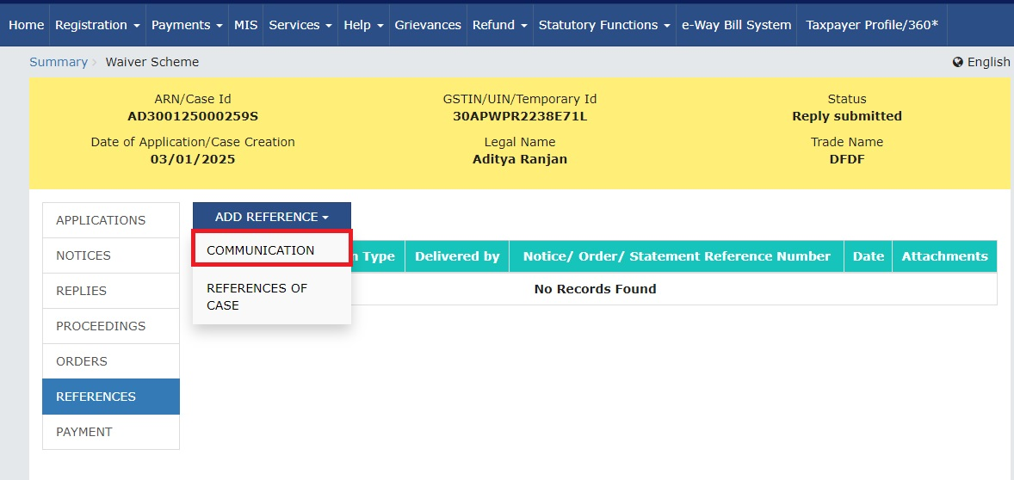
Waiver Scheme
References Tab
In Add Reference Tab – Communication and References of case can be uploaded

Slide 67
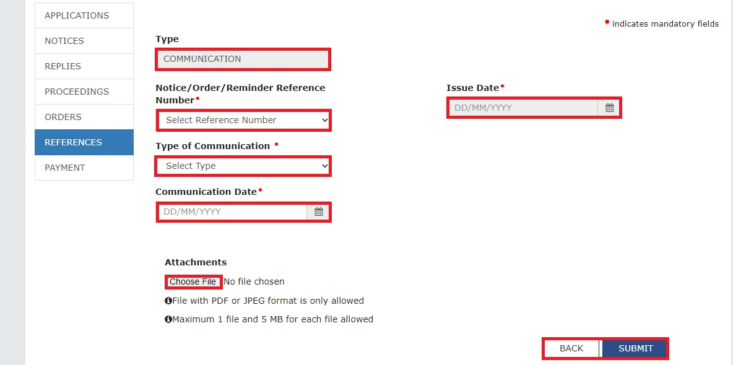
Waiver Scheme
References Tab
For communication, officer can be selected reference no. and type of communication from drop down

Slide 68
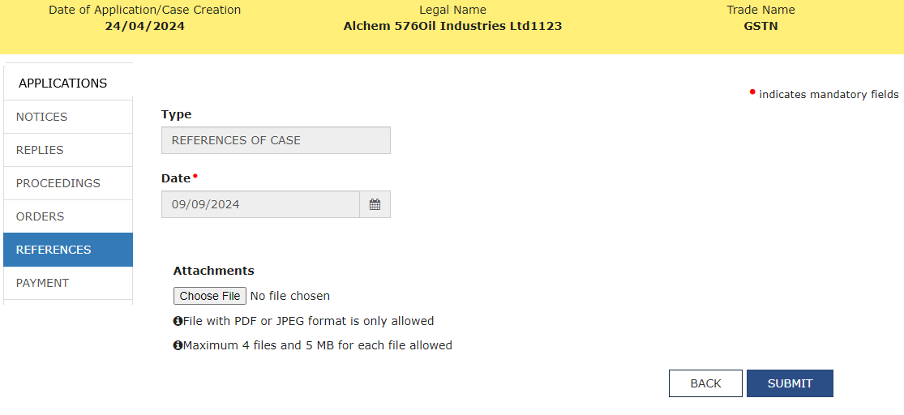
Waiver Scheme
References Tab
Supporting documents for the reference of the case can be uploaded here. It is visible to officer only

Slide 69
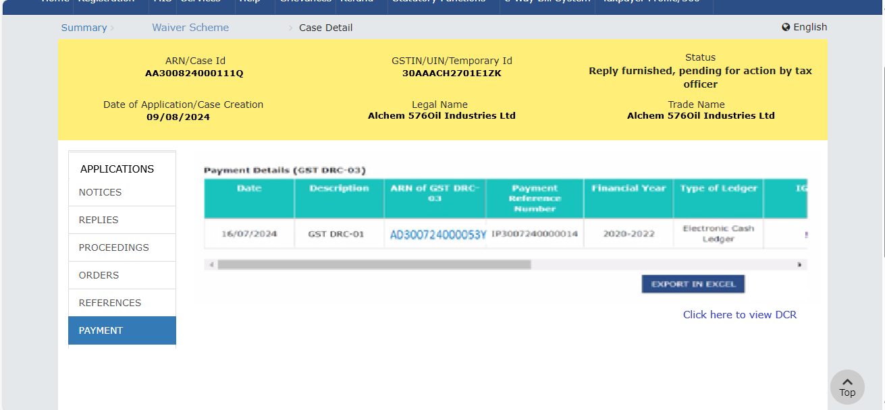
Waiver Scheme
Payment Tab
Payments made by the taxpayer in DRC-03 w.r.t the notice or statement will reflect here for Recovery officer

Slide 70
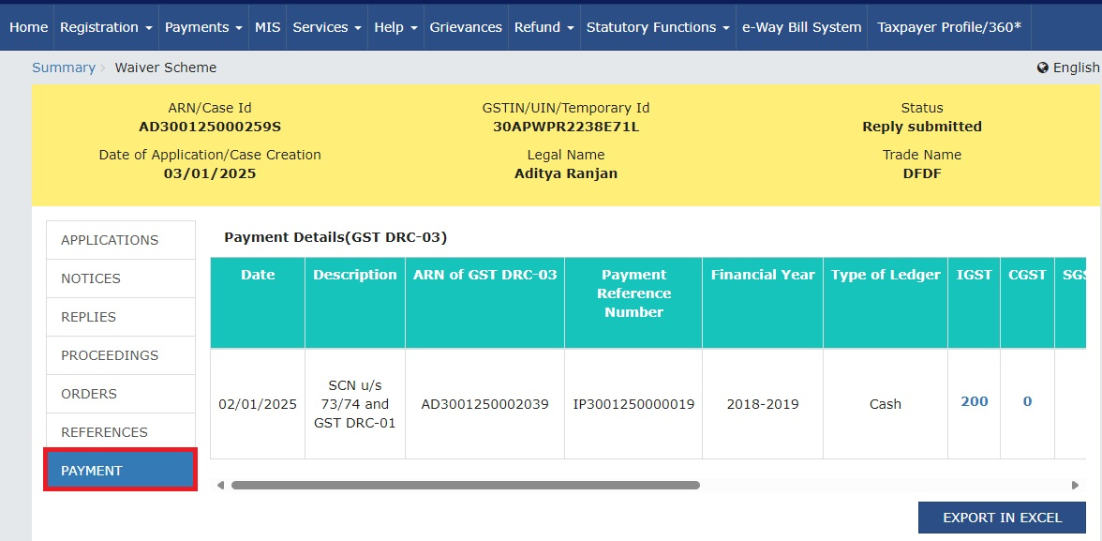
Waiver Scheme
Payment Tab
Payments made by the taxpayer in DRC-03 w.r.t the notice or statement will reflect here for Adjudicating officer

Slide 71
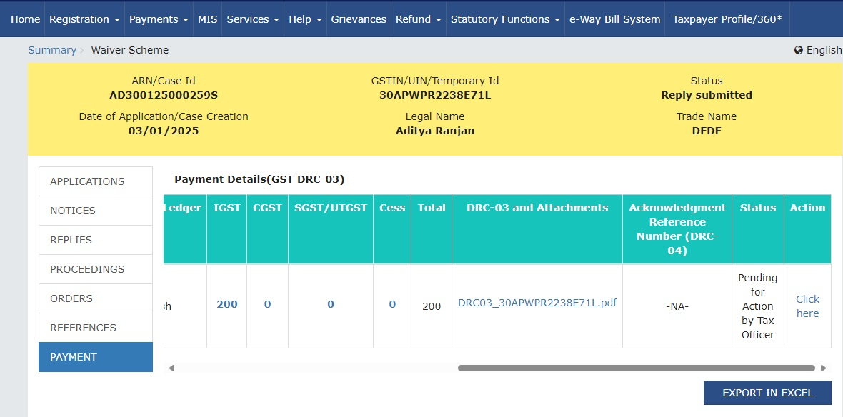
Waiver Scheme
Payment Tab
“Click here” hyperlink to navigate to the Case folder of Intimation of Voluntary Payment

Slide 72
Waiver Scheme
Payment Tab
Redirected to the DRC 03 case folder

Slide 73
Waiver Scheme
Payment
Officer restricted from issuing DRC-04 or DRC-05 till the status is ‘Taxpayer has opted for Waiver Scheme’

Slide 74
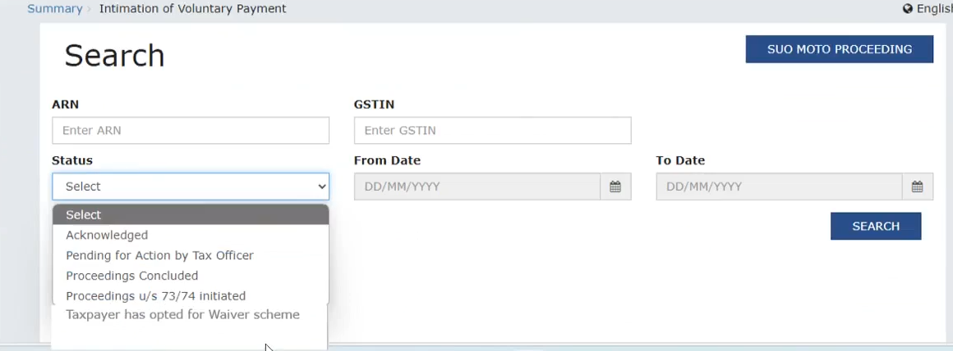
Waiver Scheme
Intimation of Voluntary Payment Case Folder
Assessment and Adjudication > Intimation of Voluntary Payment a New Status “Taxpayer has opted for Waiver scheme” has been added

Slide 75
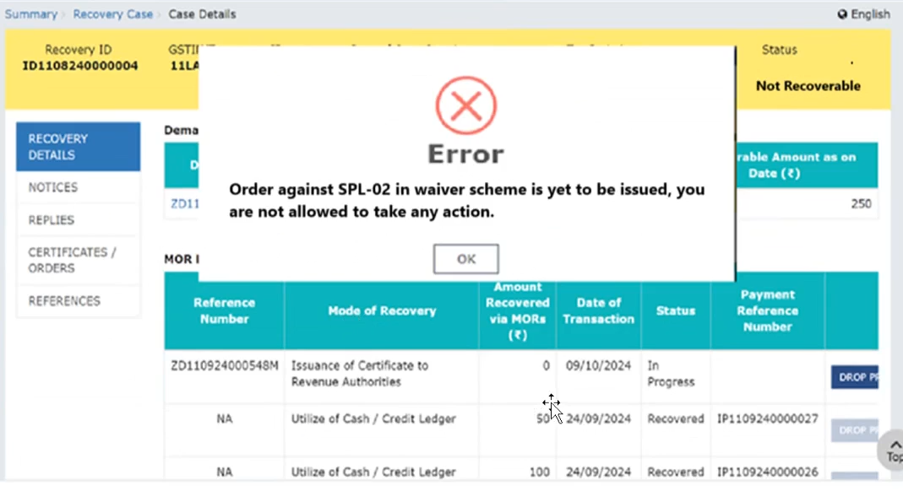
Waiver Scheme
Recovery Case Folder
Recovery officer cannot take action on Recovery ID post filing of SPL-02 until issuance of Rejection or Void Order

Slide 76
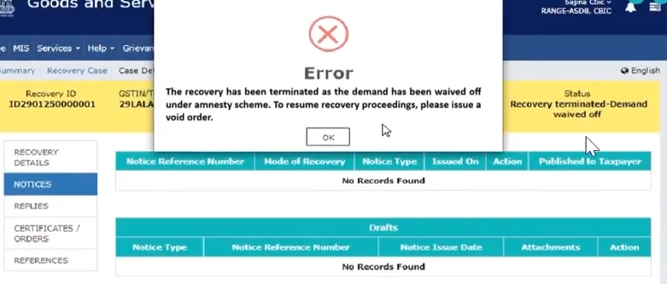
Waiver Scheme
Recovery Case Folder
On issuance of SPL 05 – Recovery is terminated

Slide 77
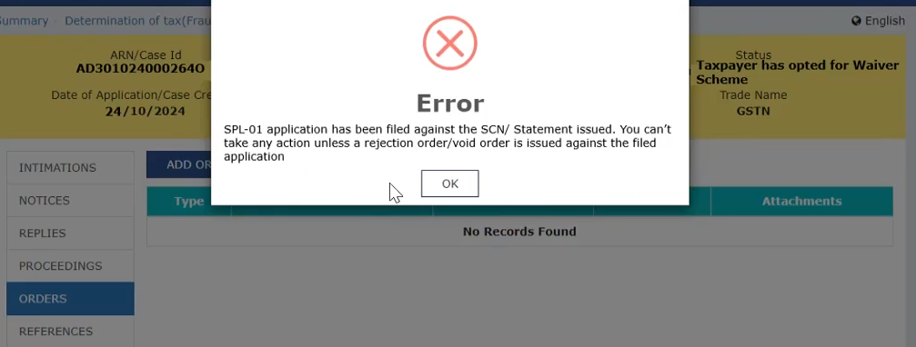
Waiver Scheme
Restriction on dashboard of Adjudicating Authority
Adjudicating officer cannot pass any Order in Assessment case folder post filing of SPL-01 until issuance of Rejection or Void Order

Slide 78
Your feedback will help us plan sessions better!
THANK YOU

